Slide 1

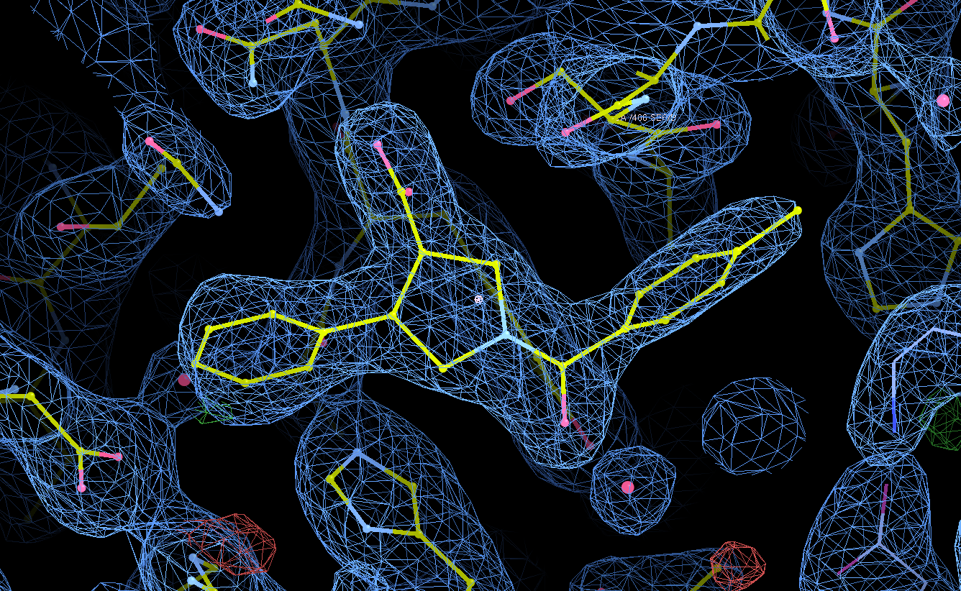
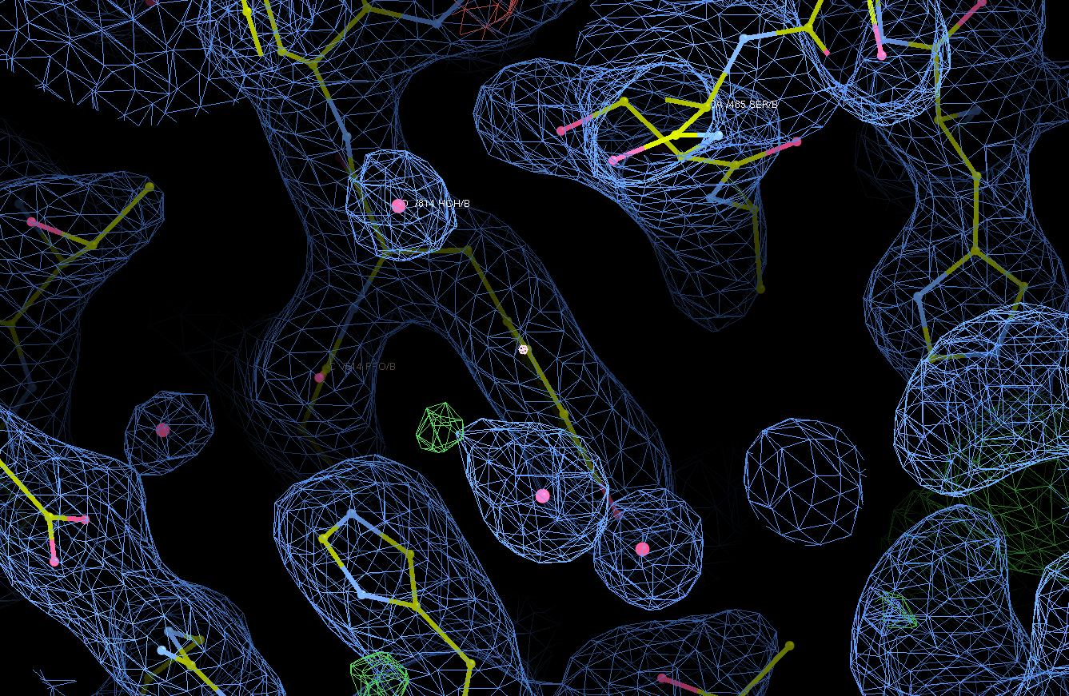
SGC Open Chemistry Networks - Project 43
One trans enantiomer binds to SARS-CoV-2 nsp13 and the other doesn’t
Calling computational chemists:
The enantiomer that bound has [α] = –40. Which is it?
https://github.com/StructuralGenomicsConsortium/CNP43_SARS-CoV-2_nsP13-Helicase_pyrrolidine/wiki/The-Story-So-Far
Contact: chemistry@thesgc.org or a.magalhaes@ucl.ac.uk
RA-0205665-01 (-40 optical rotation) – 2.13Å
RA-0205665-01 (+40 optical rotation) – 2.28Å
OR

Slide 2
SGC Open Chemistry Networks - Project 43
One trans enantiomer binds to SARS-CoV-2 nsp13 and the other doesn’t
Calling all chemists – we can separate the enantiomers by SFC.
But we’d like to resolve them on scale. Can you help?
Story so far at
https://github.com/StructuralGenomicsConsortium/CNP43_SARS-CoV-2_nsP13-Helicase_pyrrolidine/wiki/The-Story-So-Far
Contact: chemistry@thesgc.org or a.magalhaes@ucl.ac.uk

